Slide 1
Software Development 3
Abstract Classes and Interfaces

Slide 2
Abstract Classes
An Abstract class is a conceptual class.
An Abstract class cannot be instantiated – objects cannot be created.
Abstract classes cannot be instantiated, but they can be sub-classed.
Abstract classes provides a common root for a group of classes, nicely tied together in a package.

Slide 3
Why Use Abstract Classes
Abstract classes let you define base behaviour so the programmer doesn’t have to define everything (through inheritance) AND they force structure on any subclasses.

Slide 4
Abstract Class Concept
A football supporter is an abstract concept.
Is it possible to have a football supporter who does not support a specific team? …….Lets say No (ABU’s are therefore not football supporters ☺)
So if you are a football supporter you support a specific team:
  Liverpool supporter is an example of a football supporter.
  United supporter is an example of a football supporter.
  Chelsea supporter is an example of a football supporter.

Slide 5
Abstract Class Concept
The issue is we would like to exploit the commonality of the various types of football supporter objects – the issue is that the football supporter is an abstract concept and does not make sense without a concrete implementation; LiverpoolSupporter, UnitedSupporter, ChelseaSupporter
The solution is to create an abstract class called FootballSupporter.

Slide 6
Abstract Class Concept
As we create sub-classes of the abstract class (classes which extend our abstract class) they are all the same ‘type’.
This means we can put them in something like an ArrayList which only holds a specific class
  An ArrayList of Strings
  An ArrayList of integers
  An ArrayList of Football Suporters…

Slide 7
Abstract Methods
You can declare a method without defining it:
  public abstract void draw(int size);
  Notice that the body of the method is missing
A method that has been declared but not defined is an abstract method

Slide 8
Abstract Classes
Any class containing an abstract method is an abstract class
You must declare the class with the keyword abstract:
  abstract class MyClass {...}
An abstract class is incomplete
  It has “missing” method bodies
You cannot instantiate (create a new instance of) an abstract class

Slide 9
Abstract Classes
You can extend (sub-class) an abstract class
If the subclass defines all the inherited abstract methods, it is “complete” and can be instantiated
If the subclass does not define all the inherited abstract methods, it too must be abstract

Slide 10
Why have abstract classes?
Suppose you wanted to create a class Shape, with subclasses Oval, Rectangle, Triangle, Hexagon, etc.
You don’t want to allow creation of a “Shape”
  Only particular shapes make sense, not generic ones
  If Shape is abstract, you can’t create a new Shape
  You can create a new Oval, a new Rectangle, etc.
Abstract classes are good for defining a general category containing specific, “concrete” classes

Slide 11
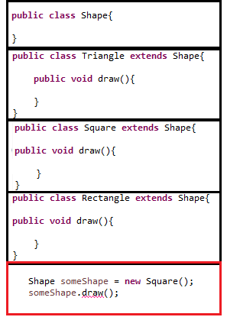
Problems with no Abstract Classes
This is legal – Square extends Shape therefore Square is a Shape….
This is also legal – a Shape is a Shape…
This is not legal – some Shape (e.g. a Circle class) may not have a draw method (here it so happens that Square does, but we cannot guarantee it will always have one!)

Slide 12
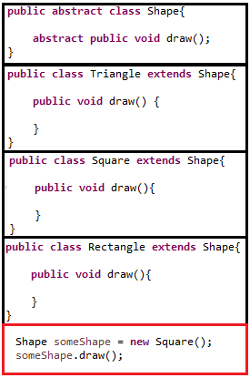
A Solution using Abstract Classes
This is legal – Square extends Shape therefore Square is a Shape….
This is not legal – Shape is abstract and cannot be instantiated
This is legal – some Shape (e.g. a Circle class) has to have a draw method (due to the draw() method in Shape being abstract, any Class that extends Shape must have a draw() method!)

Slide 13
Interfaces
An interface declares (describes) methods but does not supply bodies for them
interface KeyListener {
public void keyPressed(KeyEvent e);
public void keyReleased(KeyEvent e);
public void keyTyped(KeyEvent e);
}
All the methods are implicitly public and abstract
You cannot instantiate an interface
  An interface is like a very abstract class—none of its methods are defined

Slide 14
Implementing an Interface
You extend a class, but you implement an interface
A class can only extend (subclass) one other class, but it can implement as many interfaces as you like
Example:
  class MyListener
  implements KeyListener, ActionListener { … }

Slide 15
Implementing an Interface
When you say a class implements an interface, you are promising to define all the methods that were declared in the interface
Example:
class MyKeyListener implements KeyListener {
public void keyPressed(KeyEvent e) {...};
public void keyReleased(KeyEvent e) {...};
public void keyTyped(KeyEvent e) {...};
}
  The “...” indicates actual code that you must supply

Slide 16
Why use an Interface?
Reason 1: A class can only extend one other class, but it can implement multiple interfaces
  This lets the class fill multiple “roles”
  In writing GUIs, it is common to have one class implement several different listeners
  Example:
  class MyFrame extends JFrame
  implements ActionListener, KeyListener {
  ...
  }

Slide 17
Why use an Interface?
Reason 2: You can write methods that work for more than one kind of class.
  Consider 2 unrelated classes; car and dog
  Both car and dog pay tax; dog license and car tax
  We want to exploit the common features of these 2 seemingly unrelated classes i.e. both pay tax
  Its not logical to use a base abstract class
  We can use an interface and get both classes to implement it.

Slide 18
Definitions
abstract method—a method which is declared but not defined (it has no method body)
abstract class—a class which either (1) contains abstract methods, or (2) has been declared abstract
instantiate—to create an instance (object) of a class
interface—similar to a class, but contains only abstract methods

